Slide 1
Energy Conservation: Alternative Energy

Slide 2
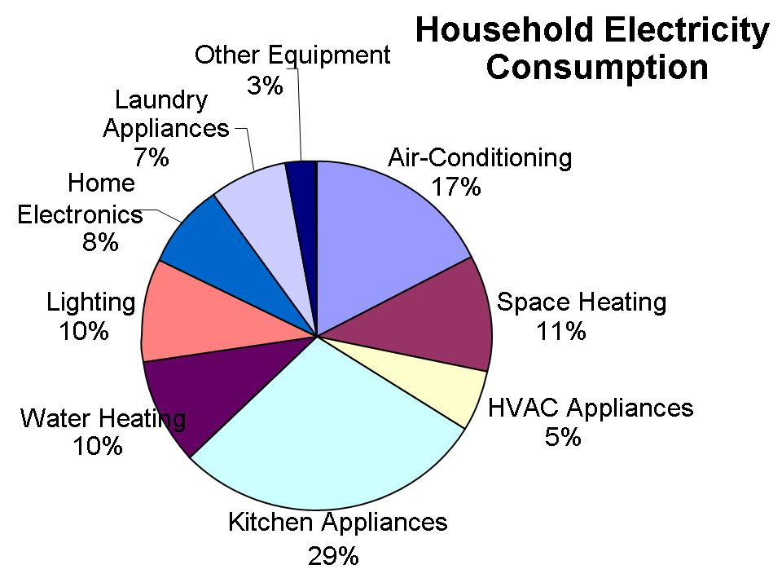

Slide 3
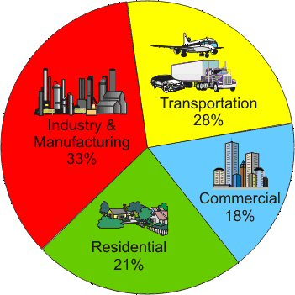
Global Energy Usage

Slide 4
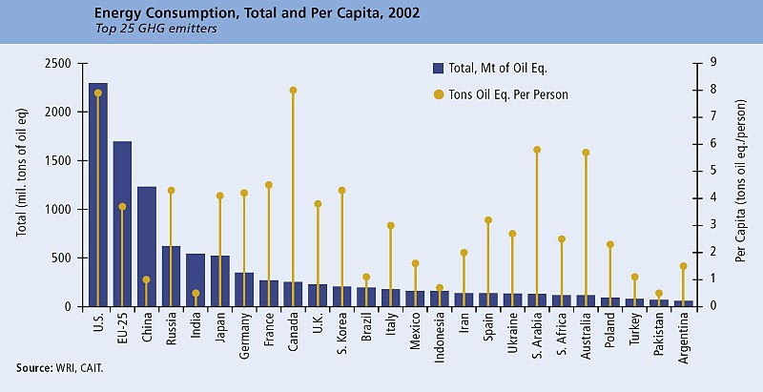
Country Analysis of Energy Consumption

Slide 5
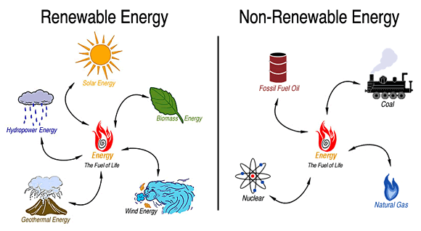
Types of Energy Sources

Slide 6
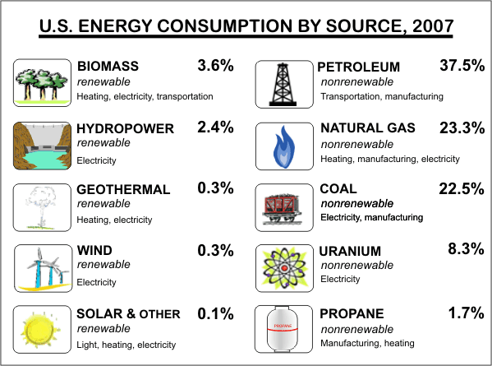

Slide 7
NONRENEWABLE RESOURCES
A nonrenewable resource is a natural resource that cannot be re-made or re-grown at a scale comparable to its consumption.

Slide 8
RENEWABLE RESOURCES
Renewable resources are natural resources that can be replenished in a short period of time.
● Solar ● Geothermal
● Wind ● Biomass
● Water

Slide 9
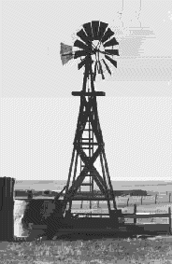
Wind Power
We've used the wind as an energy
source for a long time.
The Babylonians and Chinese were
using wind power to pump water for irrigating crops 4,000 years ago, and sailing boats were around long before that.
Wind power was used in the Middle Ages,
in Europe, to grind corn, which is where the term "windmill" comes from.

Slide 10
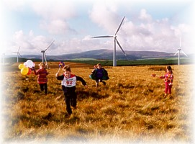
How Wind Power Works
The Sun heats our atmosphere unevenly, so some patches become warmer than others.
These warm patches of air rise, other air blows in to replace them - and we feel a wind blowing.
We can use the energy in the wind by building a tall tower, with a large propeller on the

Slide 11
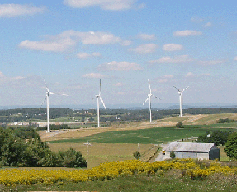
Is Wind Power Renewable?
Wind power is renewable.
Winds will keep on blowing, it makes sense to use them.

Slide 12
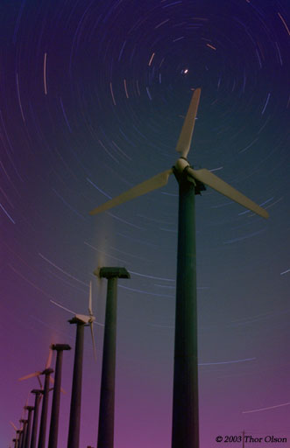
Advantages to Wind power
Wind is free, wind farms need no fuel.
Produces no waste or greenhouse gases.
The land beneath can usually still be used for farming.
Wind farms can be tourist attractions.
A good method of supplying energy to remote areas.

Slide 13
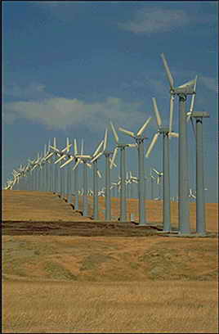
Disadvantages of Wind Power
The wind is not always predictable
some days have no wind.
Suitable areas for wind farms are
often near the coast, where land
is expensive.
Can kill birds - migrating flocks tend to like strong winds. Splat!
Noisy. A wind generator makes a constant, low, "swooshing" noise day and night.

Slide 14
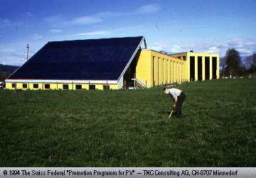
Solar Power
Solar Cells really
called photovoltaic" or "photoelectric" cells) convert light directly into electricity.
In a sunny climate, you can get enough power to run a 100W light bulb from just one square meter of solar panel.

Slide 15
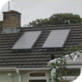
Solar Water Heating
Heat from the Sun is
used to heat water in
glass panels on your roof.
Solar heating is worthwhile in places like California and Australia, where you get lots of sunshine.

Slide 16
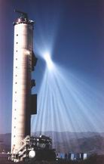
Solar Furnaces
Use a huge array of mirrors to concentrate the Sun's energy into a small space and produce very high temperatures.

Slide 17
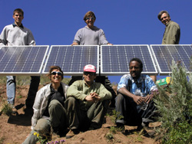
Is Solar Power Renewable?
Solar power is renewable.
The Sun will keep on shining anyway, so it makes sense to use it.

Slide 18
Advantages to solar power
Solar energy is free - it needs no fuel and produces no waste or pollution.
In sunny countries, solar power can be used where there is no easy way to get electricity to a remote place.
Handy for low-power uses such as solar powered garden lights and battery chargers

Slide 19
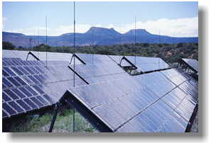
Disadvantages to Solar Power
Doesn't work at night.
Very expensive to build solar power stations. Solar cells cost a great deal compared to the amount of electricity they'll produce in their lifetime.
Can be unreliable unless you're in a very sunny climate.

Slide 20
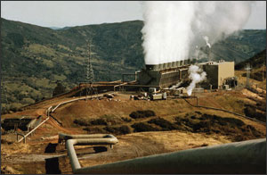
Geothermal Power
Hot rocks underground heat water to produce steam. We drill holes down to the hot region, steam comes up, is purified and used to drive turbines, which drive electric generators.
There may be natural "groundwater" in the hot rocks anyway, or we may need to drill more holes and pump water down to them.

Slide 21
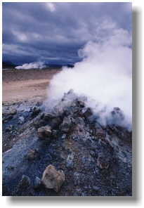
Advantages to Geothermal Power
Geothermal energy does not
produce any pollution, and
does not contribute to the
greenhouse effect.
The power stations do not take up much room, so there is not much impact on the environment.
No fuel is needed.
Once you've built a geothermal power station, the energy is almost free. It may need a little energy to run a pump, but this can be taken from the energy being generated.

Slide 22
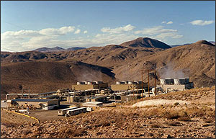
Disadvantages to Geothermal Power
The big problem is that there are not many places where you can build a geothermal power station. You need hot rocks of a suitable type, at a depth where we can drill down to them. The type of rock above is also important, it must be of a type that we can easily drill through.
Sometimes a geothermal site may "run out of steam", perhaps for decades.
Hazardous gases and minerals may come up from underground, and can be difficult to safely dispose of.

Slide 23
GEOTHERMAL
Energy from Earth’s heat.
renewable

Slide 24
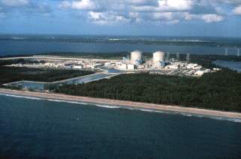
Nuclear Power
Nuclear power is
generated using Uranium, which is a metal mined in various parts of the world.
Nuclear power produces around 11% of the world's energy needs.

Slide 25
NUCLEAR ENERGY
Nuclear energy is a nonrenewable resource because once we have dug up all the Earth’s Uranium there isn’t anymore.

Slide 26
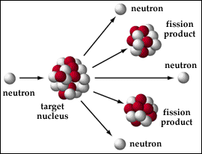
The reactor uses Uranium rods as fuel, and the heat is generated by nuclear fission. Neutrons smash into the nucleus of the uranium atoms, which split roughly in half and release energy in the form of heat.

Slide 27
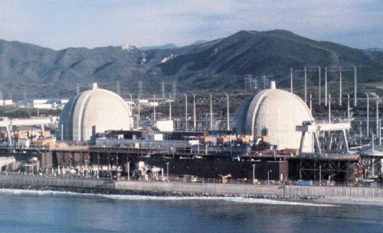
Advantages to Using Nuclear Power
Nuclear power costs about the same as coal, so it's not expensive to make.
Does not produce smoke or carbon dioxide, so it does not contribute to the greenhouse effect.
Produces huge amounts of energy from small amounts of fuel.
Produces small amounts
of waste.
Nuclear power is reliable.

Slide 28
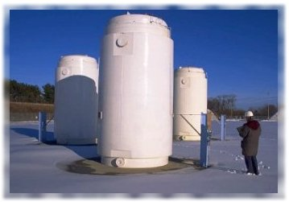
Disadvantages of Nuclear Power
Although not much waste is produced, it is very, very dangerous. It must be sealed up and buried for many years to allow the radioactivity to die away.

Slide 29
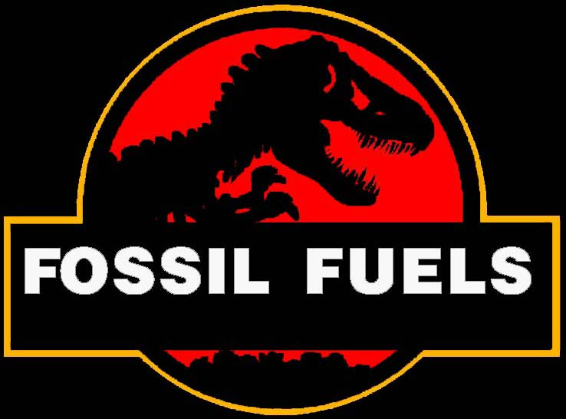
Fossil Fuels
Coal, Oil and Gas are called "fossil fuels” because they have been formed from the fossilized remains of prehistoric plants and animals.
They provide around 66% of the world's electrical power, and 95% of the world's total energy demands

Slide 30
HOW IS COAL MADE ???

Slide 31
Fossil Fuels
Coal, petroleum, and natural gas are considered nonrenewable because they can not be replenished in a short period of time. These are called fossil fuels.

Slide 32
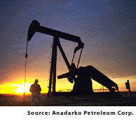
Advantages to Using Fossil Fuels
Very large amounts of electricity can be generated in one place using coal, fairly cheaply.
Transporting oil and gas to the power stations is easy.
Gas-fired power stations are very efficient.
A fossil-fuelled power
station can be built
almost anywhere

Slide 33
Disadvantages of Using Fossil Fuels
Basically, the main drawback of fossil fuels is pollution.
Burning any fossil fuel produces carbon dioxide, which contributes to the "greenhouse effect", warming the Earth.
Burning coal produces sulphur dioxide, a gas that contributes to acid rain.
Mining coal can be difficult and dangerous. Strip mining destroys large areas of the landscape.

Slide 34
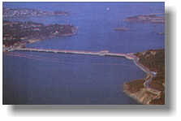
Tidal Power
Tidal power works rather like a hydro-electric scheme, except that the dam is much bigger.
A huge dam (called a "barrage") is built across a river estuary. When the tide goes in and out, the water flows through tunnels in the dam.
The ebb and flow of the tides can be used to turn a turbine, or it can be used to push air through a pipe, which then turns a turbine. Large lock gates, like the ones used on canals, allow ships to pass.
Only around 20 sites in the world have been identified as possible tidal power stations.

Slide 35
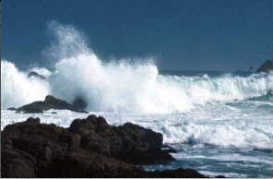
Advantages to Tidal Power
Once you've built it, tidal power is free.
It produces no greenhouse gases or other waste.
It needs no fuel.
It produces electricity reliably.
Not expensive to maintain.
Tides are totally predictable.

Slide 36
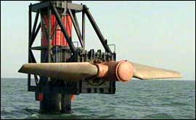
Disadvantages to Tidal Power
A barrage across an estuary is very expensive to build, and affects a very wide area - the environment is changed for many miles upstream and downstream. Many birds rely on the tide uncovering the mud flats so that they can feed. There are few suitable sites for tidal barrages.
Only provides power for around 10 hours each day, when the tide is actually moving in or out.

Slide 37
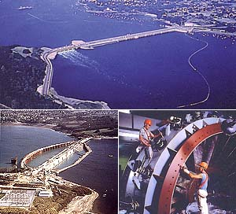
Is it Renewable?
Tidal energy is renewable.
The tides will continue to ebb and flow, and the energy is there for the taking.

Slide 38
BIOFUEL or BIOMASS
Energy from burning organic or living matter.

Slide 39
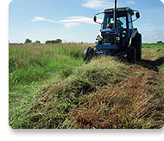
How Biomass Works
Plant and animal waste is used to produce fuels such as methanol, natural gas, and oil. We can use rubbish, animal manure, woodchips, seaweed, corn stalks and other wastes.
Sugar cane is harvested and taken to a mill, where it is crushed to extract the juice. The juice is used to make sugar, whilst the left-over pulp, called "bagasse" can be burned in a power station.
Other solid wastes, can be burned to provide heat, or used to make steam for a power station.
Burn fuel>heat water to make steam>steam turns turbine>turbine turns generator>electrical power sent around the country

Slide 40
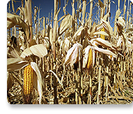
Advantages to Biomass
It makes sense to use waste materials where we can.
The fuel tends to be cheap.
Less demand on the Earth's resources.

Slide 41
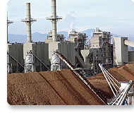
Disadvantages to Using Biomass
Collecting the waste in
sufficient quantities can be
difficult.
We burn the fuel, so
it makes greenhouse gases.
Some waste materials are not available all year round.

Slide 42
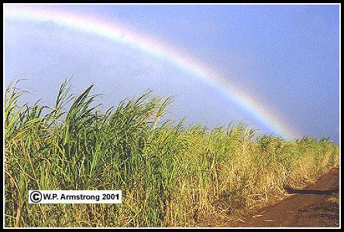
Is It Renewable?
Biomass is renewable
We will always make waste products. We can always plant & grow more sugar cane and more trees, so those are renewable too.

Slide 43
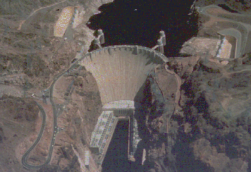
Hydroelectricity
A dam is built to trap water, usually in a valley where there is an existing lake.
Water is allowed to flow through tunnels in the dam, to turn turbines and thus drive generators.
Hydro-electricity provides 20% of the world’s power

Slide 44
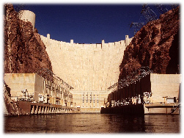
Advantages of Hydroelectricity
Once the dam is built, the energy is virtually free.
No waste or pollution produced.
Much more reliable than wind, solar or wave power.
Water can be stored above the dam ready to cope with peaks in demand.
Hydro-electric power stations can increase to full power very quickly, unlike other power stations.
Electricity can be generated constantly.

Slide 45
Advantages of Hydroelectricity
Once the dam is built, the energy is virtually free.
No waste or pollution produced.
Much more reliable than wind, solar or wave power.
Water can be stored above the dam ready to cope with peaks in demand.
Hydro-electric power stations can increase to full power very quickly, unlike other power stations.
Electricity can be generated constantly.

Slide 46
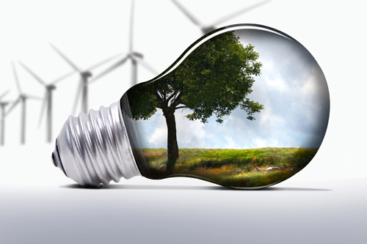
Why the need for alternative energy?

Slide 47
Reason 1: Energy Crisis
Fossil fuels (crude oil) are depleting in a rapid rate and are harder to retrieve. Non-renewable resource. New reserves have to be located fast!

Slide 48
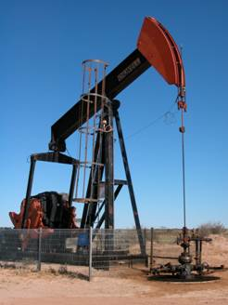
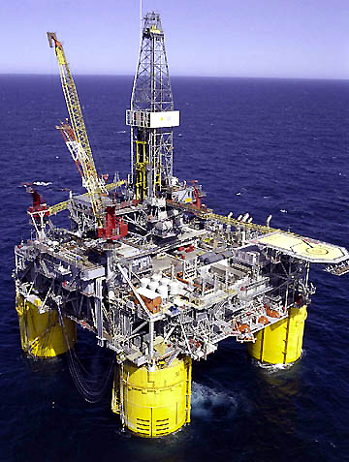
Reason 2: Environmental Impact
Ruins acres of ocean and land, affecting plant and animal habitat.

Slide 49
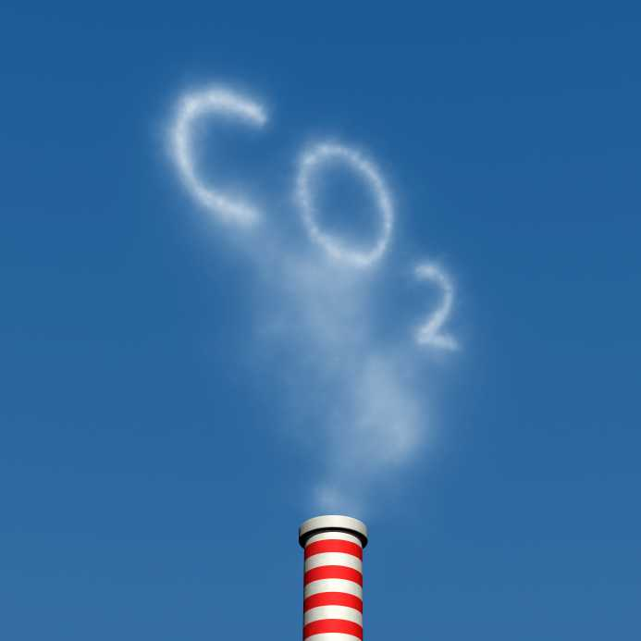
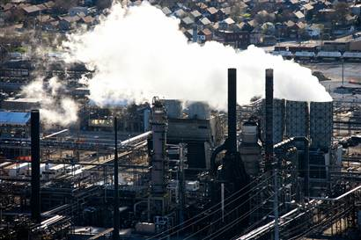
Environmental Impact: CO₂
Burning of fossil fuels increases CO₂ leading to global warming, ozone depletion

Slide 51
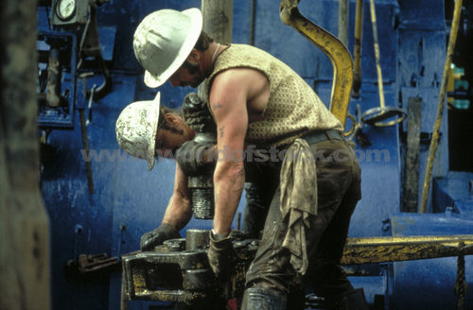
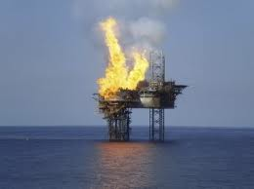
Reason 3: Human Impact
Human dangers associated with drilling, tunneling, transporting volatile liquids.

Slide 52
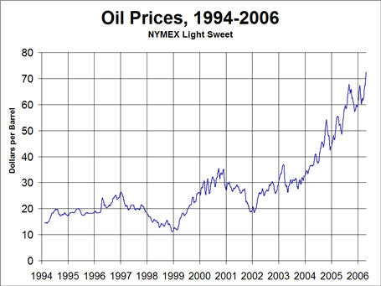
Reason 4: Too Costly!
Crude oil prices are increasing. Therefore harder for small countries to grow that are highly dependent on fossil fuels as main energy source.

