Slide 1
Practical Applications of Static Electricity

Slide 2
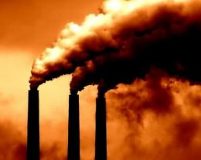
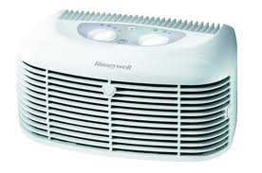
Dust Removal – Smokestacks and Air Purifiers

Slide 3

Removing Smoke from Power Station Chimnies
No smoke leaves the chimney
Negative Plate
Positive Plate
Charge up the Smoke

Slide 4
Dust Removal – Smokestacks and Air Purifiers
Opposite Charged plates attract charged and uncharged particles, thereby purifying the air.

Slide 5
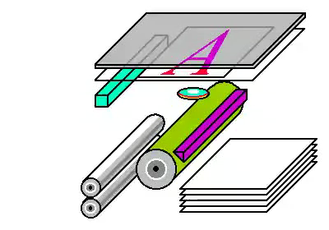
Photocopiers - Xerography
http://www.youtube.com/watch?v=HFxo4j1EWsA

Slide 6
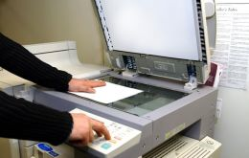
Photocopiers
Copy machines use static to make ink get attracted to the areas where the paper to be copied is darker (i.e. words / images).

Slide 7
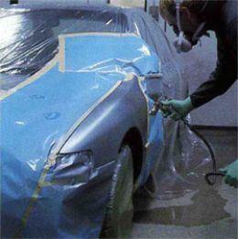
Electrostatic Painting
http://www.youtube.com/watch?v=zTwkJBtCcBA&feature=related

Slide 8
Spraying a Car
Metal body of the car is submerged in substance gives it a negative charge
Paint is charged Positive with Spray gun
No paint is wasted as the positive car attracts the negative paint. Ensures a uniform layer.
Electrostatic paint job is stronger and lasts longer than if it were just sprayed

Slide 9
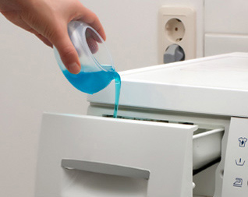
Fabric Softeners: Static Cling
Fabric softeners work by coating the surface of the cloth fibers with a thin layer of chemicals so that the clothes appear to all be made out of the same material.
Like charges repel – no static cling!

Slide 10
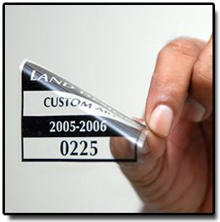
Static Cling Window Decals
Window decals are made from heavily plasticized vinyl that carries a high static charge. When adhered to a smooth, clean surface (such as glass or a smooth plastic or metal surface), the static cling label adheres easily.

